Slide 1
LECTURE ON
Unsigned and Signed Binary Numbers

Slide 2
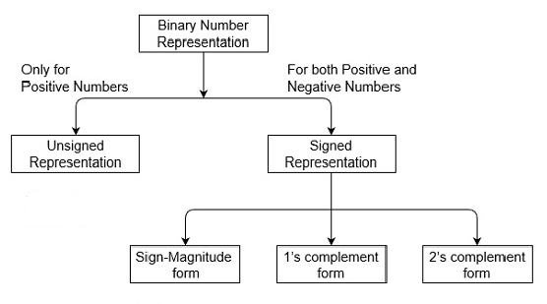
Unsigned and Signed Binary Numbers

Slide 3
Unsigned Binary Numbers
Unsigned numbers don’t have any sign, these can contain only magnitude of the number. So, representation of unsigned binary numbers are all positive numbers only. For example, representation of positive decimal numbers are positive by default. We always assume that there is a positive sign symbol in front of every number.
Representation of Unsigned Binary Numbers:
Since there is no sign bit in this unsigned binary number, so N bit binary number represent its magnitude only.
The range of unsigned binary number is from 0 to (2^{n}-1).
n= number of bits

Slide 4
Unsigned Binary Numbers Examples
Example 1 : Represent decimal number 92 in unsigned binary number.
Simply convert it into Binary number, it contains only magnitude of the given number. = (92)₁₀
= (1011100)₂
It’s 7 bit binary magnitude of the decimal number 92

Slide 5
Unsigned Binary Numbers
Example 2: Represent decimal number 47 in unsigned binary number.
Simply convert it into Binary number, it contains only magnitude of the given number. = (47)₁₀
= (101111)₂
It’s 6 bit binary magnitude of the decimal number 92

Slide 6
Signed Binary Numbers
In real life we have to represent signed numbers (like:-12, -45, -32, +11, 12).
Three different systems have been used
Signed magnitude Representation
One’s complement Representation
Two’s complement Representation
NOTE: For negative numbers the sign bit is always 1, and for positive numbers it is 0 in these three systems.

Slide 7
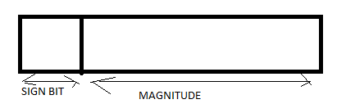
1.Signed Magnitude Representation
The leftmost bit is the sign bit (0 is + and 1 is - ) and the remaining bits hold the absolute magnitude of the number
Examples
-47 = 1 0 1 0 1 1 1 1
47 = 0 0 1 0 1 1 1 1

Slide 8
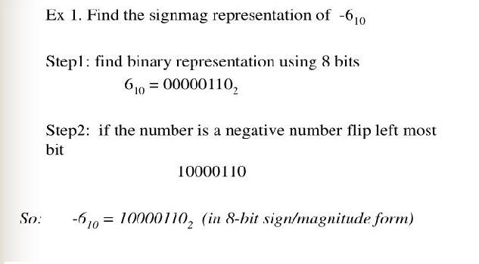
Example:

Slide 9
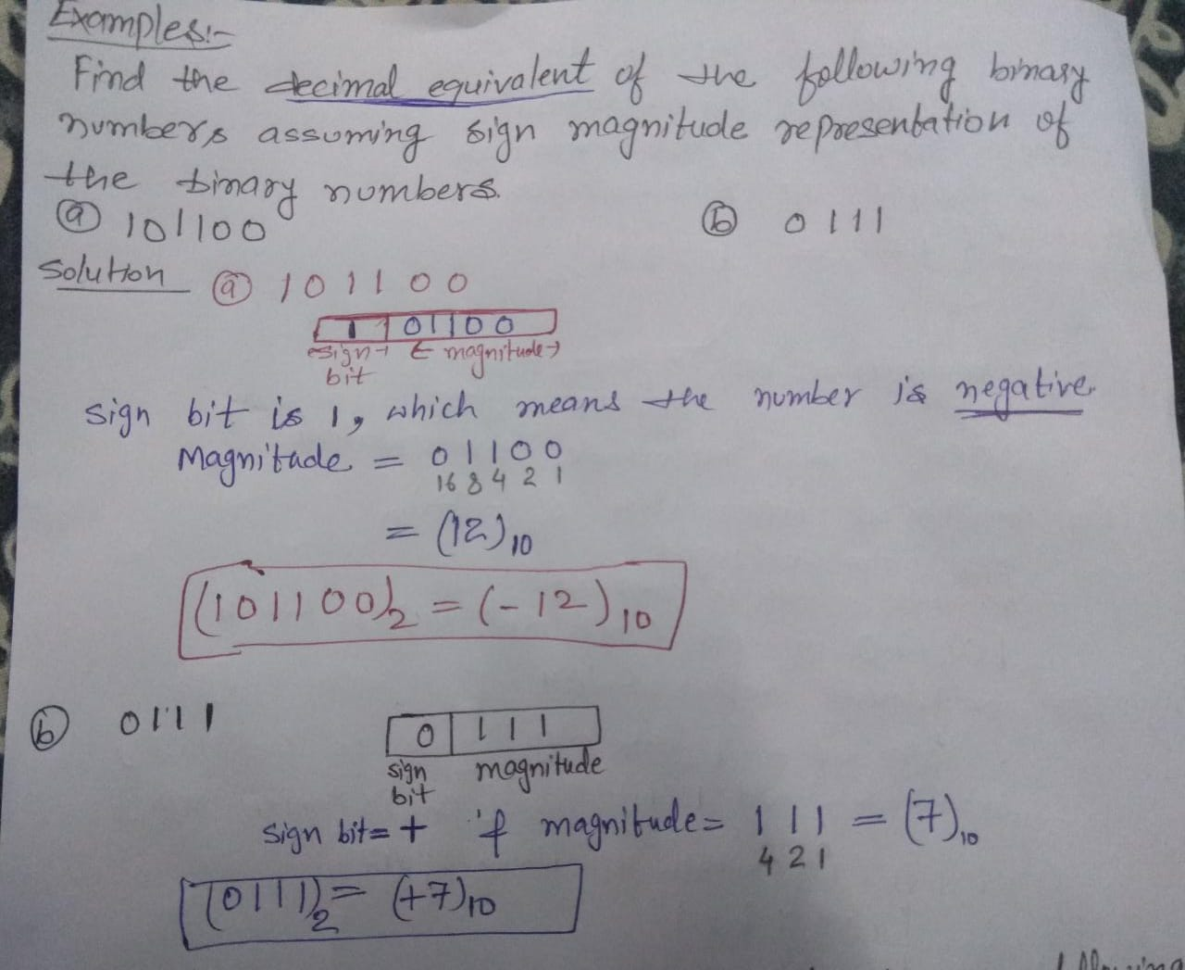
Example:

Slide 10
2. 1’S COMPLEMENT REPRESENTATION
In a binary number, if each 1 is replaced by 0 and each 0 by 1, the resulting number is known as the one’s complement of first number.
1’s complement of 101 is 010
1’s complement of 1011 is 0100
In fact both the numbers are complementing each other. If one of these number is positive, then the other number will be negative with same magnitude and vice versa.
Ex. (0101) represent (+5) whereas
(1010) represent (-5) in 1’s complement representation.

Slide 11
3. 2’S COMPLEMENT REPRESENTATION
If 1 added to 1’s complement of a binary number ,the resulting number is known as the 2’s complement of the binary number.
2’s complement of 101 is 010+1=011
2’s complement of 1011 is 0100+1=0101
. (0101) represent (+5) whereas
(1011) represent (-5) in 2’s complement representation.
In this representation also (same as 1‘s complement ) if the MSB is 0 the number is positive, whereas if the MSB is 1 the number is negative.

Slide 12
Example: Represent Decimal number -168 in (i) signed magnitude representation (ii) 1's complement representation (iii) 2's complement representation
Solution: Binary representation of 168 = 10101000
(i) signed magnitude representation of -168 :
in a sign magnitude representation first bit is stored for sign bit and remaining for magnitude of a number so
So for -168 =
(-168) = 110101000 in sign magnitude representation.
(ii) 1's complement representation of (-168) :
So for -168 =
(-168) = (101010111) in 1’s complement representation.
SIGN BIT | MAGNITUDE
1 | 10101000
SIGN BIT | 1’s complement of 1010 1000
1 | 01010111

Slide 13
(ii) 2's complement representation of (-168)
SIGN BIT | 2’s complement of 1010 1000
So for -168 =
(-168) = (101011000) in 2’s complement representation.
1 | 01011000

Slide 14
Example: Represent Decimal number -44 in (i) signed magnitude representation (ii) 1's complement representation (iii) 2's complement representation
Solution: Binary representation of 44 = 101100
(i) signed magnitude representation of -44 :
in a sign magnitude representation first bit is stored for sign bit and remaining bit for magnitude of a number so here
first bit=sign bit= 1 and remaining bit=magnitude = 101100
(-44) = 1101100 in sign magnitude representation.
(ii) 1's complement representation of (-44) :
first bit=sign bit= 1 and remaining bit= 1’s complement of (101100)=010011
(-44) = (1010011) in 1’s complement representation.
(ii) 2's complement representation of (-44) :
first bit=sign bit= 1 and remaining bit= 2’s complement of (101100)=010100
(-44) = (1010100) in 2’s complement representation.

Slide 15
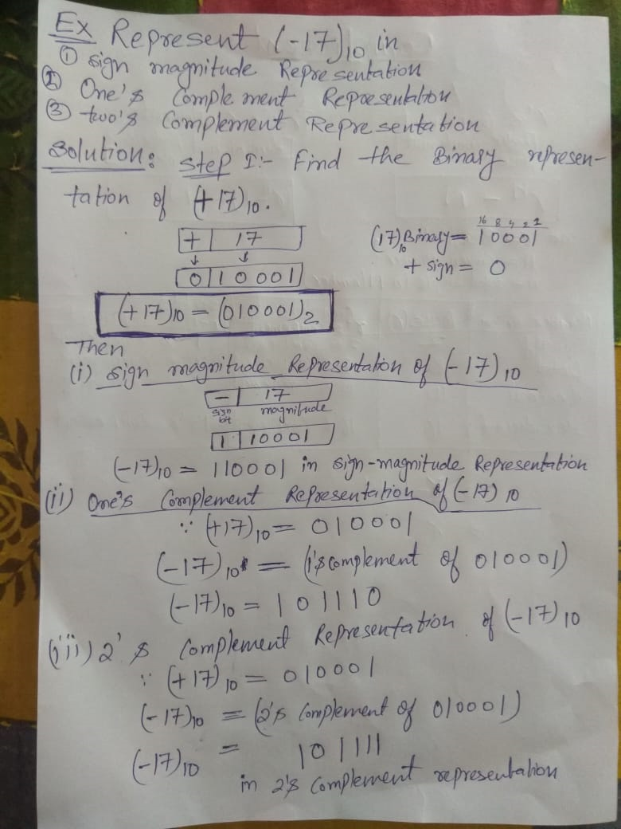
Example:

Slide 16
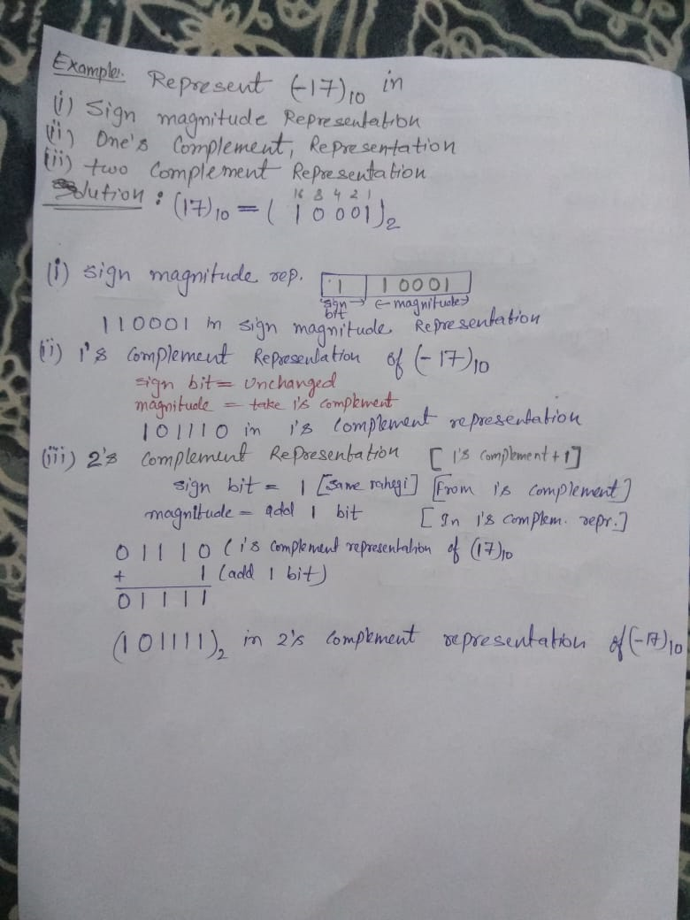
Example: same example

Slide 17
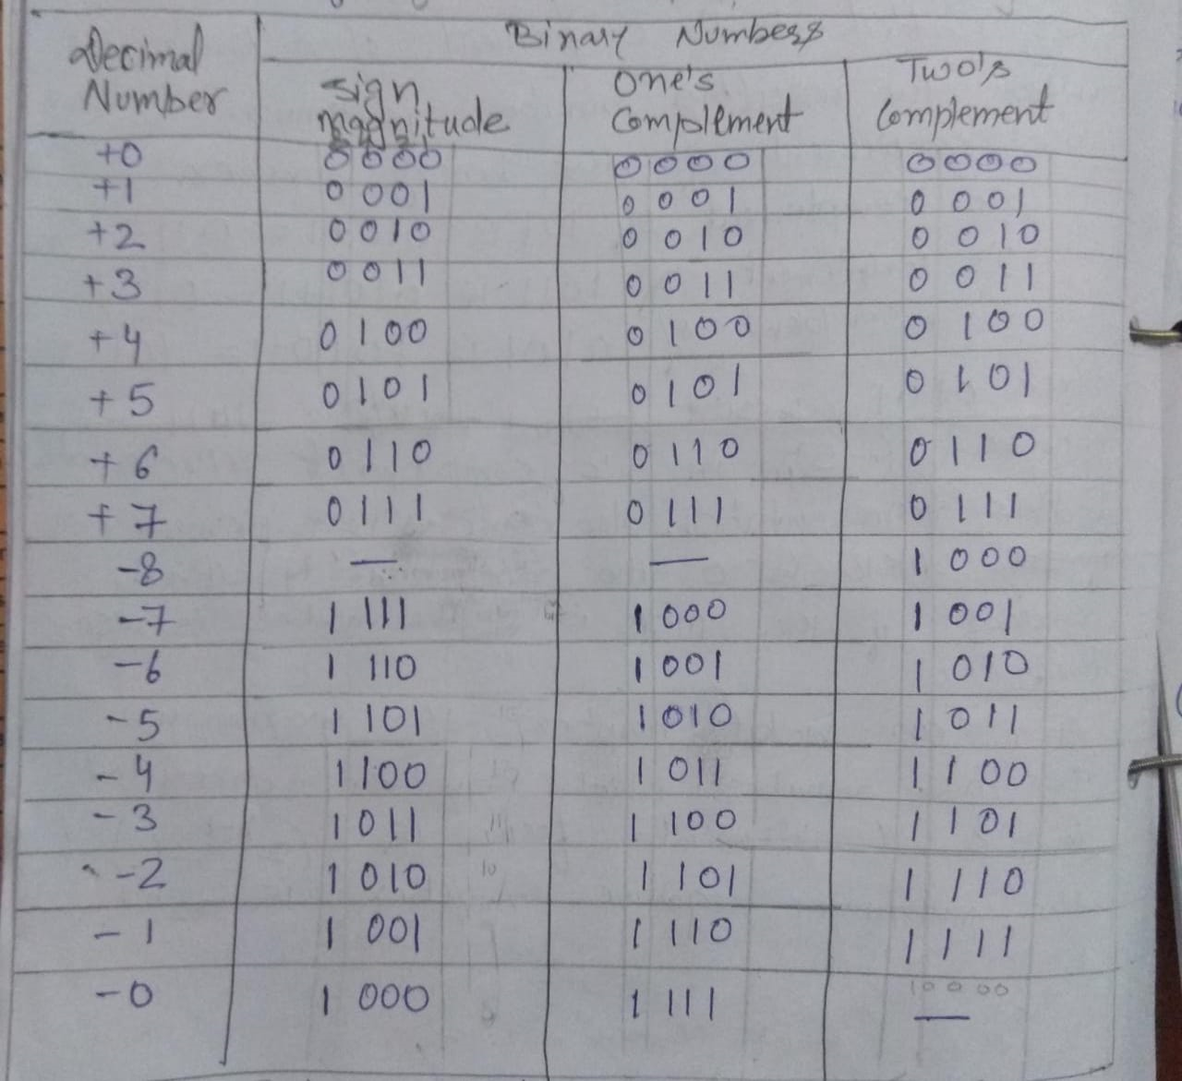
Sign magnitude,1’s complement & 2’s complement Representation using four bit

Slide 18
Example: Convert the sign magnitude binary number N=01100 a negative value having the same magnitude.
Answer:

Slide 19
Example: What decimal number does the signed magnitude binary number N=10011 represent?
Answer:

Slide 20
Example: What unsigned binary number is represented by the string of bits 11001.
Answer:

Slide 21
Example: Which bit of a signed binary number represent the sign?
Answer:

